Slide 1

Introduction to Graphs
Presented by Prof. Goble
Dickinson College Spring 2024

Slide 2
Graphs
A Graph is a finite non-empty set of vertices and a finite, possibly empty, set of edges

Slide 3
Graph Applications
Vertices are things, and the edges are relationships between them
Computer Networks
Vertex: Computer
Edge: Network Connection
Transportation Networks
Vertex: Location
Edge: Transportation method (road, train, air route)
Task Planning
Vertex: Task
Edge: Conflicts or dependencies

Slide 4
More Examples
Google Maps
Flight Networks
GPS Navigation
Social Media
Neural Networks

Slide 5
Graph Notation
A Graph is a finite non-empty set of vertices and a finite, possibly empty, set of edges
G = <V, E>
V = set of vertices
|V| = number of edges
E = set of edges
|E| = number of edges

Slide 6
Types of Graphs
Different applications will require different kinds of graphs
Undirected Graphs
Directed Graphs
Weighted Graphs

Slide 7
Can we represent an undirected graph with a directed graph?

Slide 8
Undirected Graph
Edges in undirected graphs do not have a direction
(a, c) = (c, a)
G = <V, E>
V = {a, b, c, d, e, f}
E = {(a, b), (a, c), (a, d), (b, d), (b,f), (c, d), (d, f)}

Slide 9
Can we determine the minimum and maximum number of edges?

Slide 10
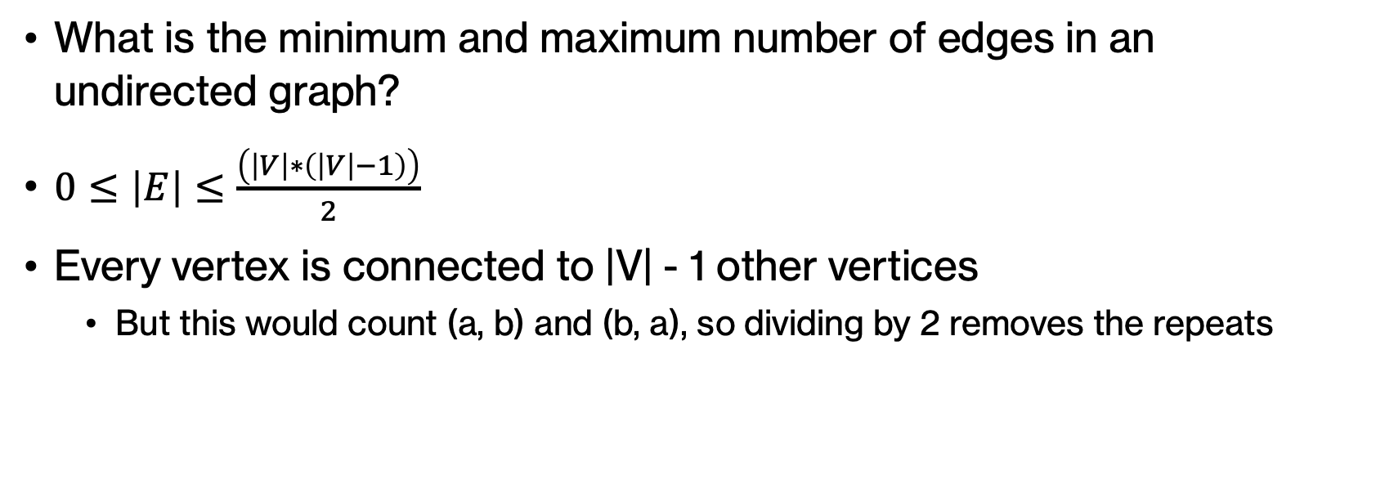
Undirected Graph
What is the minimum and maximum number of edges in an undirected graph?
$0≤\left|E\right|≤\frac{\left(\left|V\right|∗\left(\left|V\right|−1\right)\right)}{2}$
Every vertex is connected to |V| - 1 other vertices
But this would count (a, b) and (b, a), so dividing by 2 removes the repeats

Slide 11
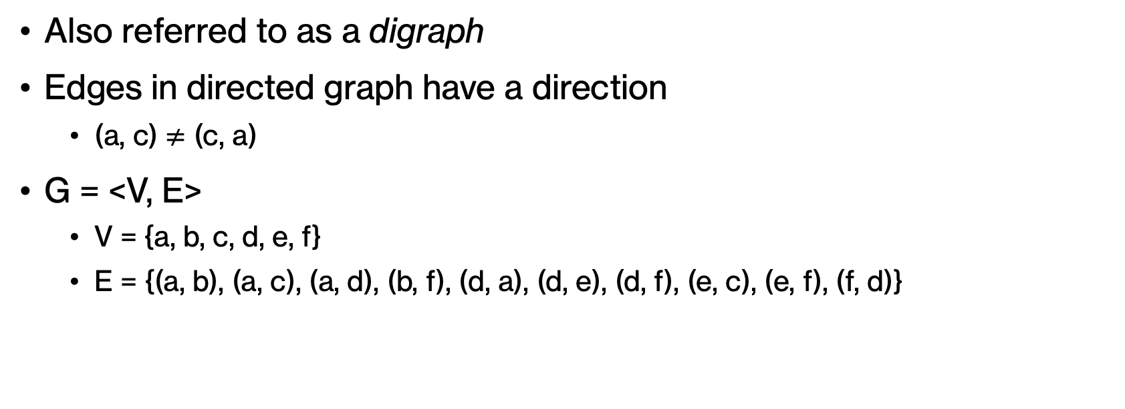
Directed Graphs
Also referred to as a digraph
Edges in directed graph have a direction
(a, c) $≠$ (c, a)
G = <V, E>
V = {a, b, c, d, e, f}
E = {(a, b), (a, c), (a, d), (b, f), (d, a), (d, e), (d, f), (e, c), (e, f), (f, d)}

Slide 12
Can we determine the minimum and maximum number of edges?

Slide 13
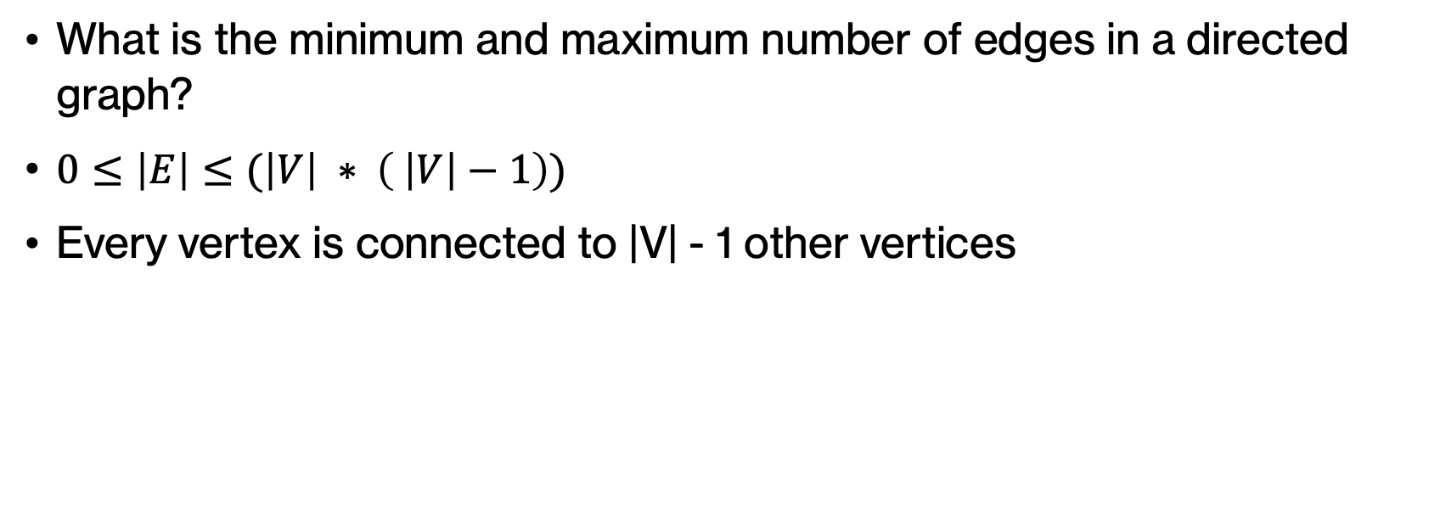
Directed Graph
What is the minimum and maximum number of edges in a directed graph?
$0≤\left|E\right|≤(\left|V\right| ∗ \left( \left|V\right|−1\right))$
Every vertex is connected to |V| - 1 other vertices

Slide 14
Graph Terminology
Neighbors
Vertex Degree: Number of edges connected to a vertex
In degree
Out degree
Path: A sequence of vertices visited
[a ,b, f, d, e]
Path length: Number of edges that the path contains
Simple Path: All Vertices are distinct
Cycles: When a path starts and ends ay the same location
Simple Cycles: All distinct points except for the start/end location
Acyclic graph: A graph with no cycles
Directed Acyclic Graph (DAG): A directed graph with no cycles
Loop

Slide 15
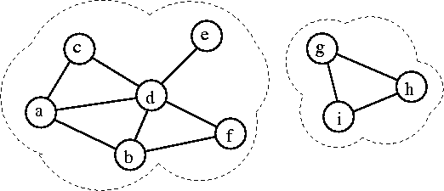
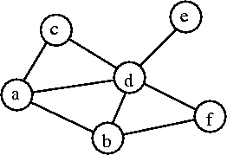
Graph Structures
Connected Graph: A Graph in which all vertices are connected
Connected Component: A maximal subgraph of a given graph
A set of nodes forms a connected component in an undirected graph if any node from the set of nodes can reach any other node by traversing edges. The main point here is reachability.

Slide 16
Graph Density
Density: |E| / |V|
Sparse Graph: A graph with a small number of edges relative to its number of vertices
Dense Graph: A graph with almost all possible edges
Complete Graph: A graph containing all possible edges
K_{|V|}: A complete graph with |V| vertices

Slide 17
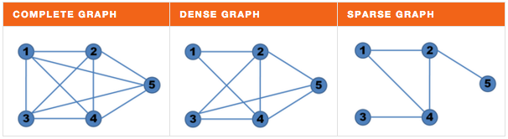
Graph Density

Slide 18
Graph Representation

Slide 19
Adjacency Matrix

Slide 20
Adjacency List

Slide 21
Adding Vertices to Graph
In our implementation, when we first create a graph we will establish all the possible vertices that we want to work with
The aim of our graph will be to add edges and handle traversing through the graph

Slide 22
addEdge(int v1, int v2, E value)

Slide 23
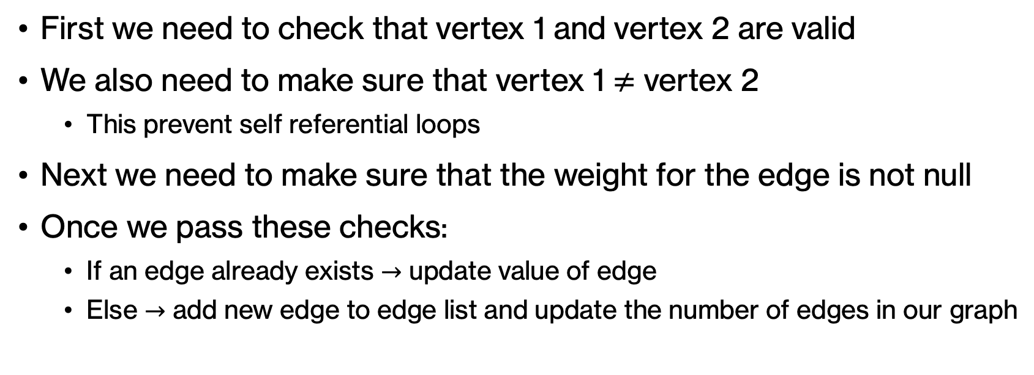
Adding Edges
First we need to check that vertex 1 and vertex 2 are valid
We also need to make sure that vertex 1 $≠$ vertex 2
This prevent self referential loops
Next we need to make sure that the weight for the edge is not null
Once we pass these checks:
If an edge already exists $→$ update value of edge
Else $→$ add new edge to edge list and update the number of edges in our graph

Slide 24
getEdge(int v1, int v2)

Slide 25
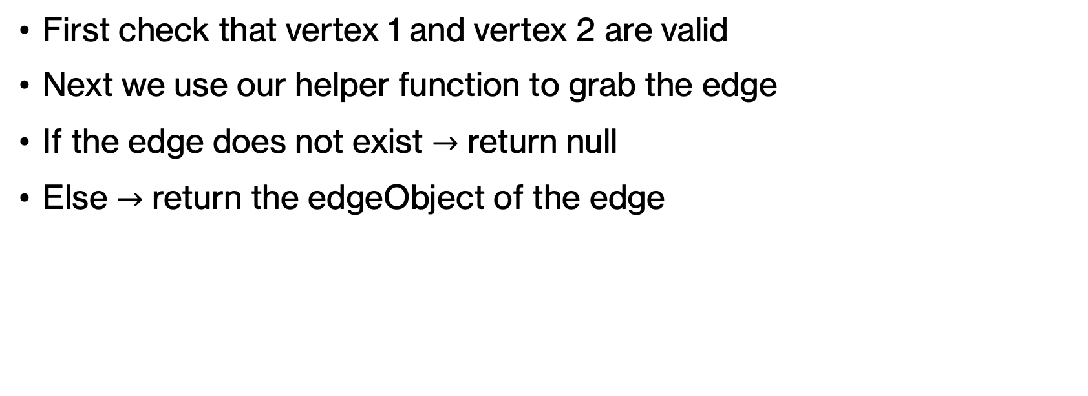
Get Edge
First check that vertex 1 and vertex 2 are valid
Next we use our helper function to grab the edge
If the edge does not exist $→$ return null
Else $→$ return the edgeObject of the edge

Slide 26
removeEdge(int v1, int v2)

Slide 27
Remove Edge (Adjacency List)
Check that Vertex 1 and Vertex 2 are valid
Grab the linked list for the given edge
Use the edge iterator to move through the list until we find the target edge
Use the Linked List remove function to remove this edge from the list
Return the edgeObject if the edge exists, otherwise return null

Slide 28
getNeighbors(int v)

Slide 29
Get Neighbors (Adjacency List)
First we want to check that our vertex is valid
Then we can make a list of all the possible neighbors
Use the list iterator to traverse through the edgeList
While the iterator has additional values, add these to our neighbors list
Return the list of neighbors

Slide 30
Get Neighbors (Adjacency Matrix)
Check that our vertex is valid
Create a list to store all neighbors
Iterate through the 2d edge list and add each non-null element to the neighbors list
Return neighbors list

